Slide 1
Static Analysis of Spring PetClinic
Task 2 - SonarQube & jQAssistant Analysis
FPSS · TU Dresden · Group 15
Objectives
Tools Used
Project
Analyze code quality
Analyze architecture
Evaluate future-proof metrics
Find strengths & weaknesses
SonarQube
jQAssistant + Neo4j
Cypher Queries
GitHub CI/CD
Spring PetClinic
Group 15

Slide 2
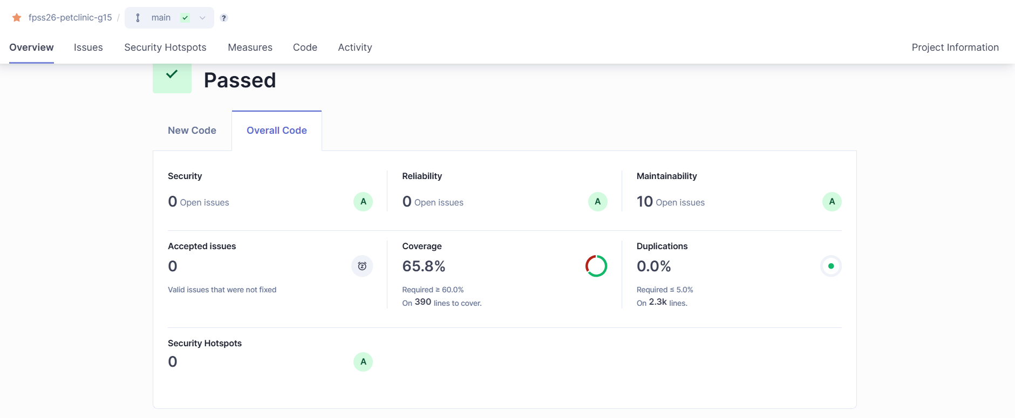
SonarQube Results Overview

Slide 3
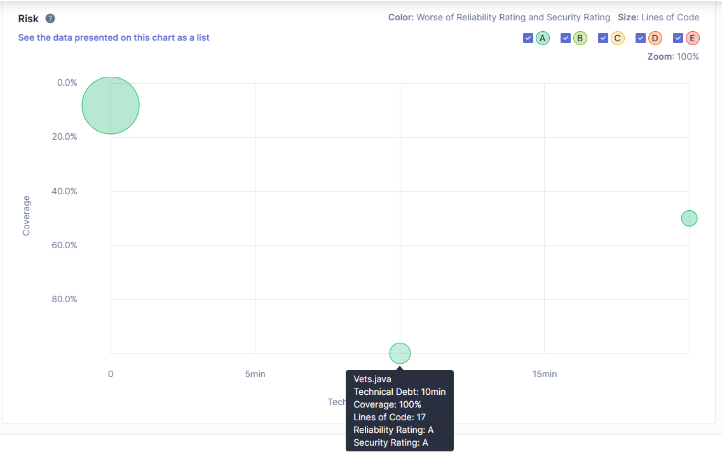
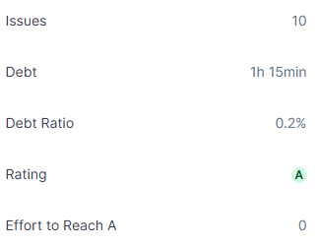
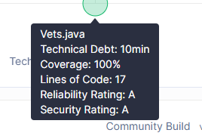
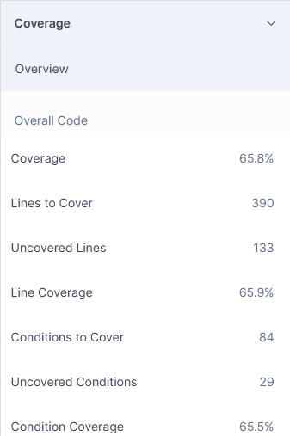
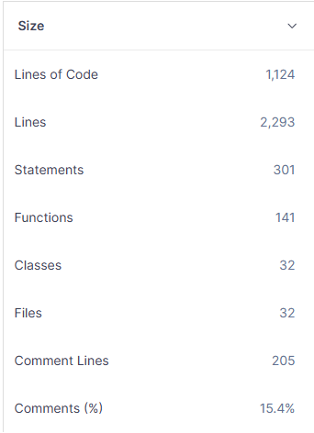
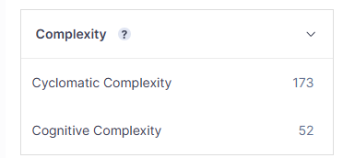
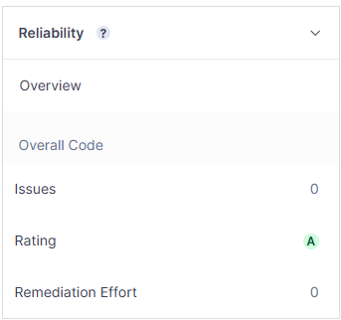
How Can SonarQube Detect Weaknesses?
WEAKNESSES DETECTED
Code smells & maintainability issues
Duplicated code blocks
Low test coverage gaps
Potential bugs
Security vulnerabilities
Technical debt accumulation
KEY BENEFITS
Early detection of quality problems
Continuous quality monitoring
CI/CD pipeline integration
Long-term maintainability support
Cognitive complexity scoring
Management-friendly debt metrics

Slide 4
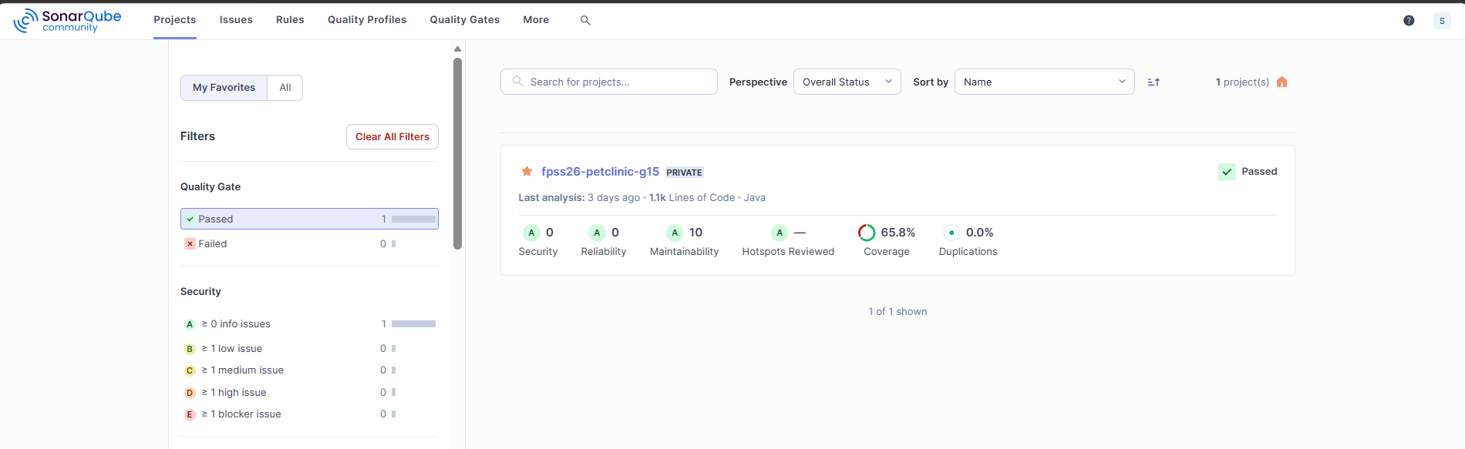
Useful Quality Gates
A Quality Gate is an automated pass/fail checkpoint in the CI/CD pipeline that blocks a release if the code does not meet defined quality conditions.
Quality Gate | Threshold | Our Result | Why It Matters
Coverage | ≥ 60% | 65.8% | Close to threshold. Untested features reduce this over time.
Duplications | ≤ 5% | 0.0% | Zero duplication. Reduces maintenance effort and redundancy.
Security | A | A | Indicates no security issues were detected.
Reliability | A | A | Zero bugs detected. System behaves correctly.
Maintainability | Not worse than B | A | Only minor (10) code smells. Codebase remains easy to change and extend.
Hotspots Reviewed | 0 hotspots or 100% reviewed | 0 hotspots | No security hotspots required review.

Slide 5
Weaknesses of SonarQube
Limitations
- SonarQube cannot
Verify business logic correctness
Limited ability to detect performance bottlenecks
Cannot reliably detect runtime memory leaks
Limited architectural analysis compared to specialized tools (e.g., jQAssistant)
Static rules may not fully understand framework-specific design intentions
- Metric Gaming:
Teams can write trivial tests just to hit coverage thresholds
Quality gate passing does not mean code is actually well-tested
- Small Project Limitation:
Our PetClinic project is too small to trigger many meaningful SonarQube insights
Most metrics show 0 issues — not because the code is perfect, but because the codebase is small
SonarQube becomes truly useful only at larger scale with many contributors
- False Positives:
Some issues may not be actual problems.
Example: TODO comments are reported as maintainability issues.
- Context-Insensitive Rules:
Rules are generic — no distinction between critical and non-critical code
A violation in a utility class is treated the same as one in core business logic
- Coverage Limitation: High coverage does not guarantee bug-free software.

Slide 6
Future-Proof Software Metrics
Metrics derived from FPSS lecture concepts and measured via SonarQube and jQAssistant.
Metrics Selected
The selected metrics are based on:
Reuse Factor
Coupling Analysis
Technical Debt Ratio
Duplication Ratio
Coverage
Future-Proof Qualities Evaluated
Reusability
Maintainability
Changeability
Technical Debt
Architecture Quality
Encapsulation
Metric | Tool | Future-Proof Aspect
Reuse Factor | jQAssistant | Reusability
Coupling Analysis | jQAssistant | Changeability
Technical Debt Ratio | SonarQube | Maintainability
Duplication Ratio | SonarQube | Architecture Quality
Coverage | SonarQube | Reliability of Evolution

Slide 7
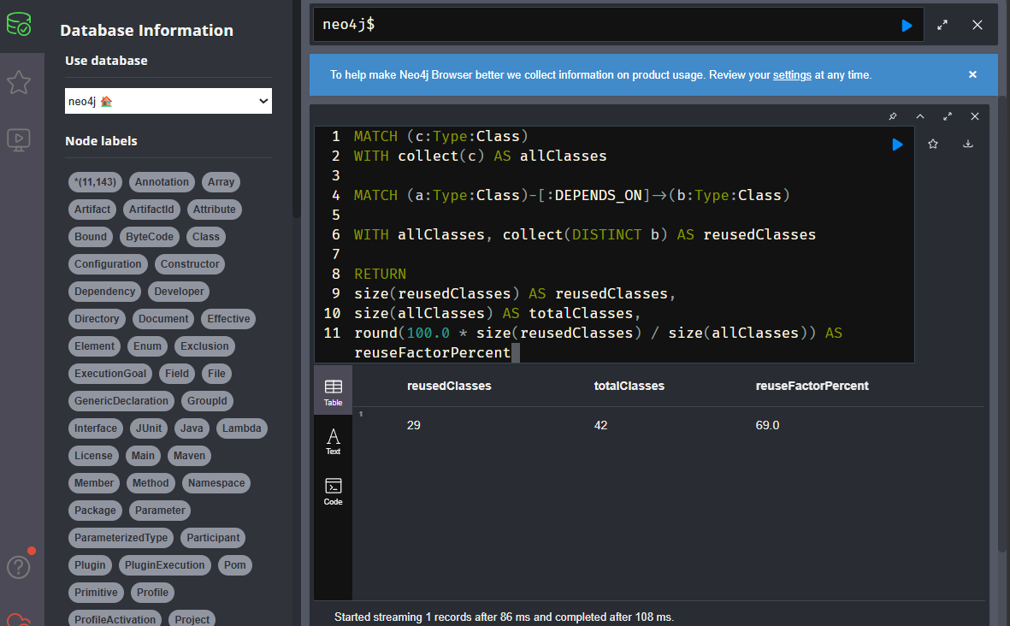
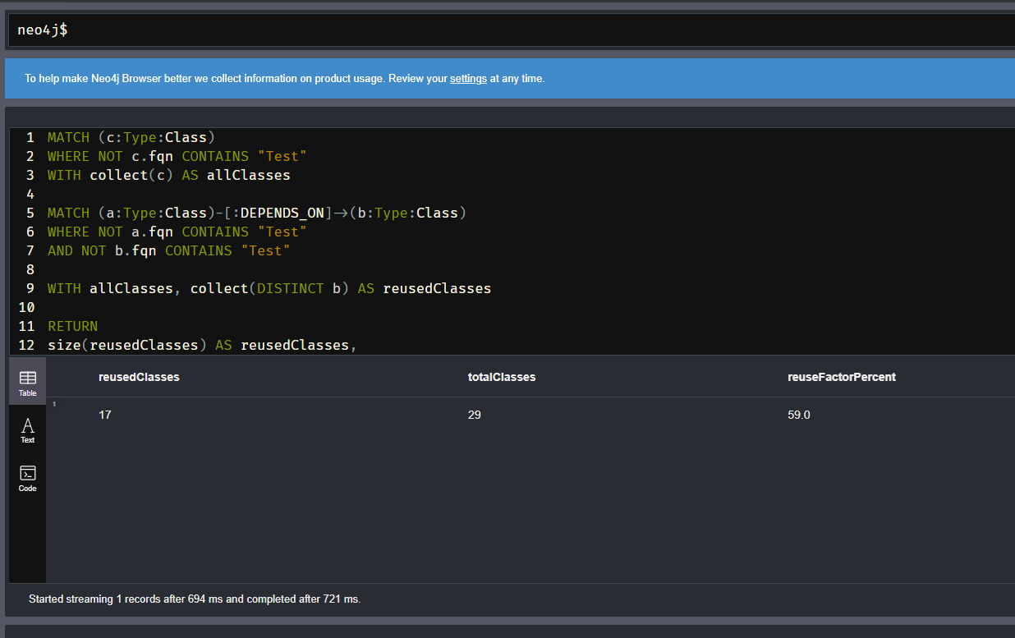
Reuse Factor Analysis · Q-1
Interpretation
69% → Whole Project, 59% → Production System
The difference shows that test code introduces additional dependency relationships and therefore increases the apparent level of reuse.
Future-Proof Software Interpretation
Even after excluding test classes:Reuse Factor = 59%, which means:
More than half of the production classes are reused.
The application exhibits a reasonable level of modularity.
Reusable components reduce future implementation effort.
Reuse supports maintainability and long-term evolution.
Production Classes
+
Test Classes
Only Production Classes
Formula: Reuse Factor = Reused Classes / Total Classes

Slide 8
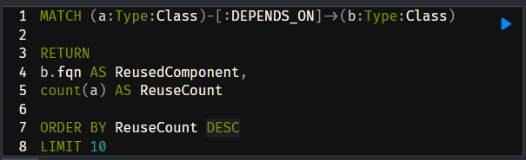
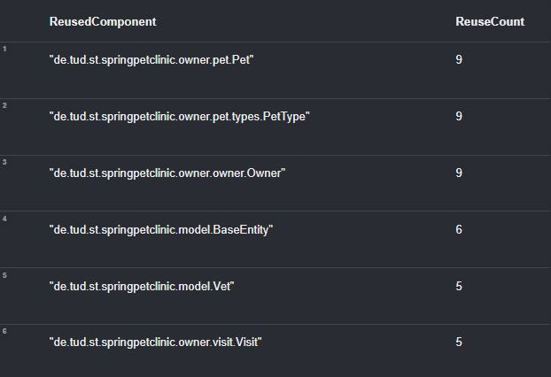
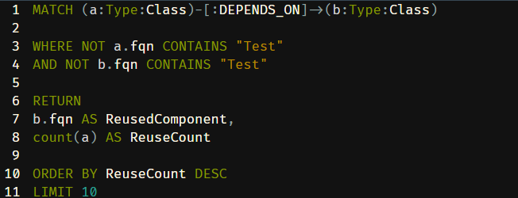
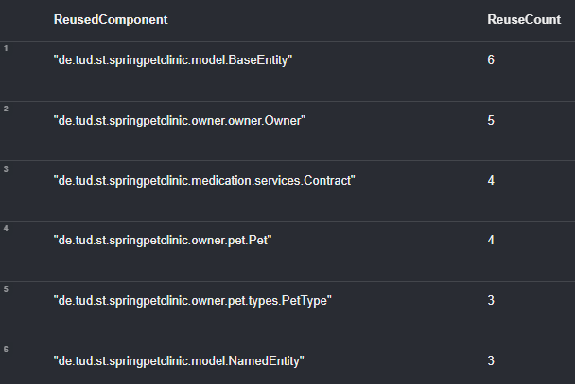
Most Reused Components · Q-2
Interpretation:
After excluding test classes, the reuse count decreases. This gives a more realistic view of the actual application architecture. BaseEntity, Owner, Contract, and Pet are the most reused production assets.
Including tests: reuse is higher because test classes also depend on domain classes.
Production only: reuse is lower but more meaningful for architecture analysis.
Future-Proof Interpretation:
The production-only result shows that core domain/model classes are reused across multiple application components. This supports:
modularity
maintainability
reduced duplication
lower future change cost
Production Classes + Test Classes
Only Production Classes

Slide 9
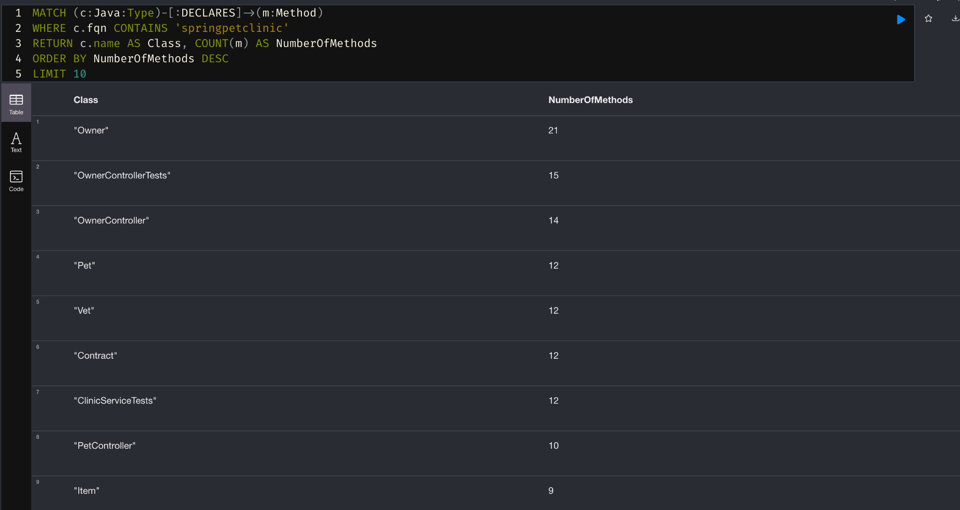
Methods per Class in PetClinic · Q-3
INTERPRETATION & FUTURE-PROOF RELEVANCE
Owner has 21 methods — most complex class, central business entity of the system
OwnerController (14) & Contract (12) reflect new functionality added in Task 1
Pet and Vet (12 each) — core domain classes, method count is appropriate
Test classes appear in top results — indicates test coverage proportional to complexity
High-method-count classes are highest maintenance risk — first affected by requirement changes
Potential God Class candidates — should be monitored and refactored as system scales

Slide 10
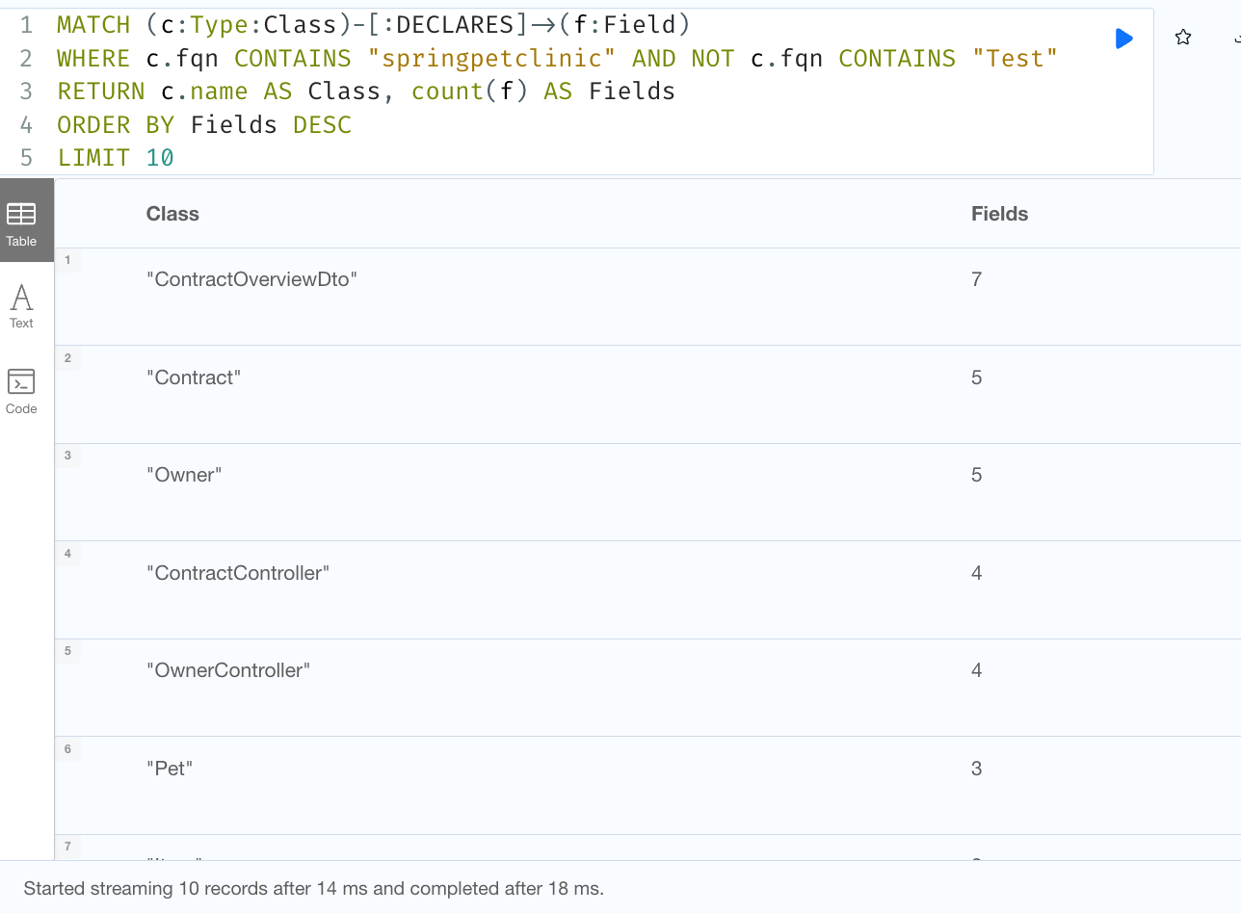
Fields per Class in PetClinic · Q-4
INTERPRETATION & FUTURE-PROOF RELEVANCE
Counts fields per class; how much state each class holds
Field counts are low across the board (max 7); no data-heavy god classes
ContractOverviewDto (7) tops the list; but that's expected: a DTO exists to bundle data for display
Owner and Contract (5 each) are highest among real domain classes; also top in methods (Q3), so Owner is the main god-class candidate to watch
Future-Proof Aspect: for Maintainability low state complexity now prevents god classes later

Slide 11
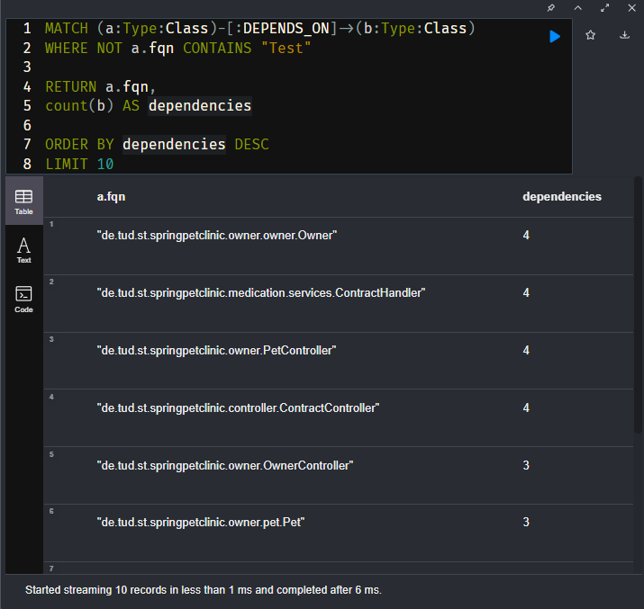
Coupling Analysis · Q-5
Interpretation
No class exhibits excessive dependency on other components.
The dependency structure is relatively lightweight.
Changes are less likely to propagate across many components.
The architecture demonstrates moderate coupling.
Future-Proof Relevance
Lower coupling improves maintainability.
Components can evolve more independently.
Changes become easier to implement and test.
Reduced coupling lowers the risk of architecture erosion over time.

Slide 12
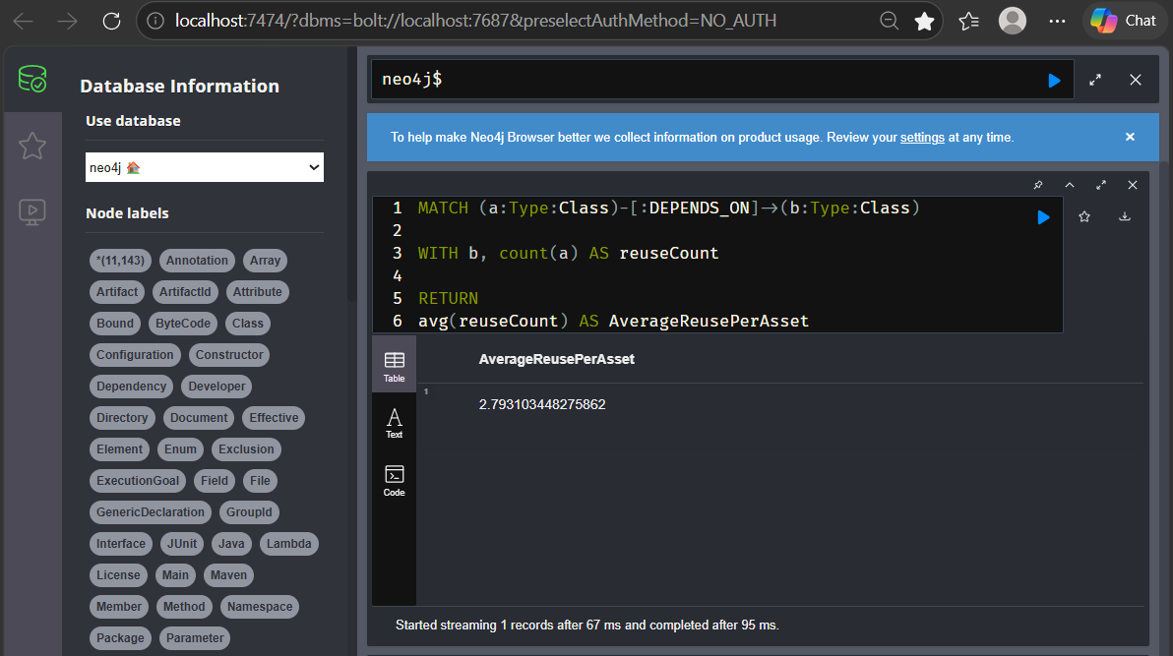
Reuse Cost-Benefit Relation · Q-6
Cost-Benefit Perspective
Each shared component serves approximately 2.8 consumers on average.
Components are reused across multiple parts of the system rather than being single-use.
Reuse increases the return on development effort invested in shared assets.
Reusable abstractions reduce redundant implementation work.
The benefits of reuse grow as the system evolves and scales.
Future-Proof Relevance
Improves maintainability through shared and consistent implementations.
Reduces duplication and simplifies future modifications.
Supports modular software evolution.
Enables lower long-term maintenance costs.
Contributes to sustainable and future-proof software architecture.

Slide 13
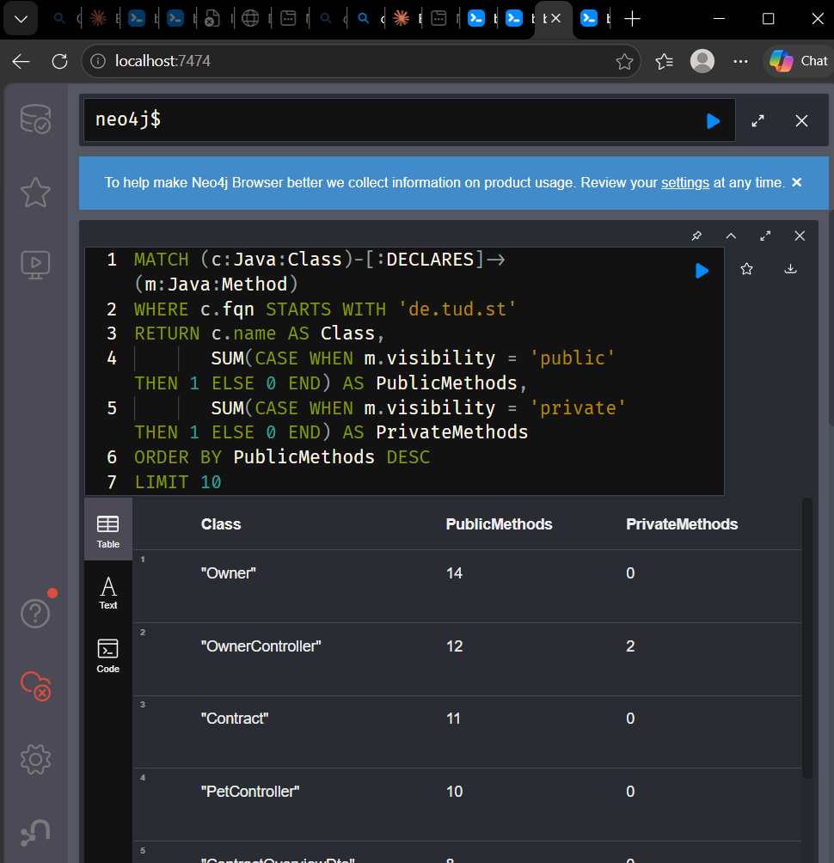
Visibility of Methods (public vs private) · Q-7
Measures public vs private method ratio per class to evaluate encapsulation quality
8 out of 10 classes have 0 private methods.
Owner (14 public, 0 private) is the most over-exposed class in the project
Contract, Item and UsedItem — our added classes — also have 0 private methods, making future changes risky
Only OwnerController (2 private) and ContractHandler (1 private) show minimal encapsulation
INTERPRETATION & FUTURE-PROOF RELEVANCE

Slide 14
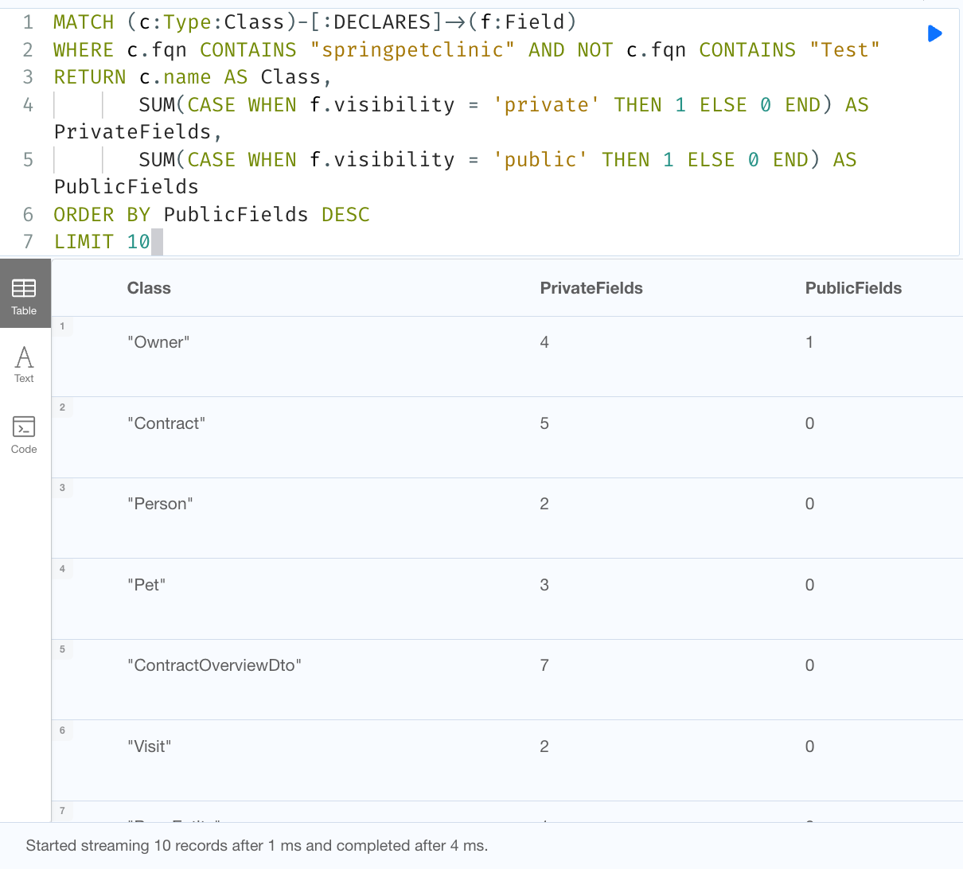
Visibility of Fields (public vs private fields) · Q-8
INTERPRETATION & FUTURE-PROOF RELEVANCE
Measures field-level encapsulation; whether data is private (protected) or public (exposed)
9 of 10 classes have 0 public fields
Owner exposes one public field, bookedServices (its list of contracts), not a constant, a real leaked instance field
Any class can read/modify it directly, so the list can't be validated, logged, or refactored safely later

Slide 15
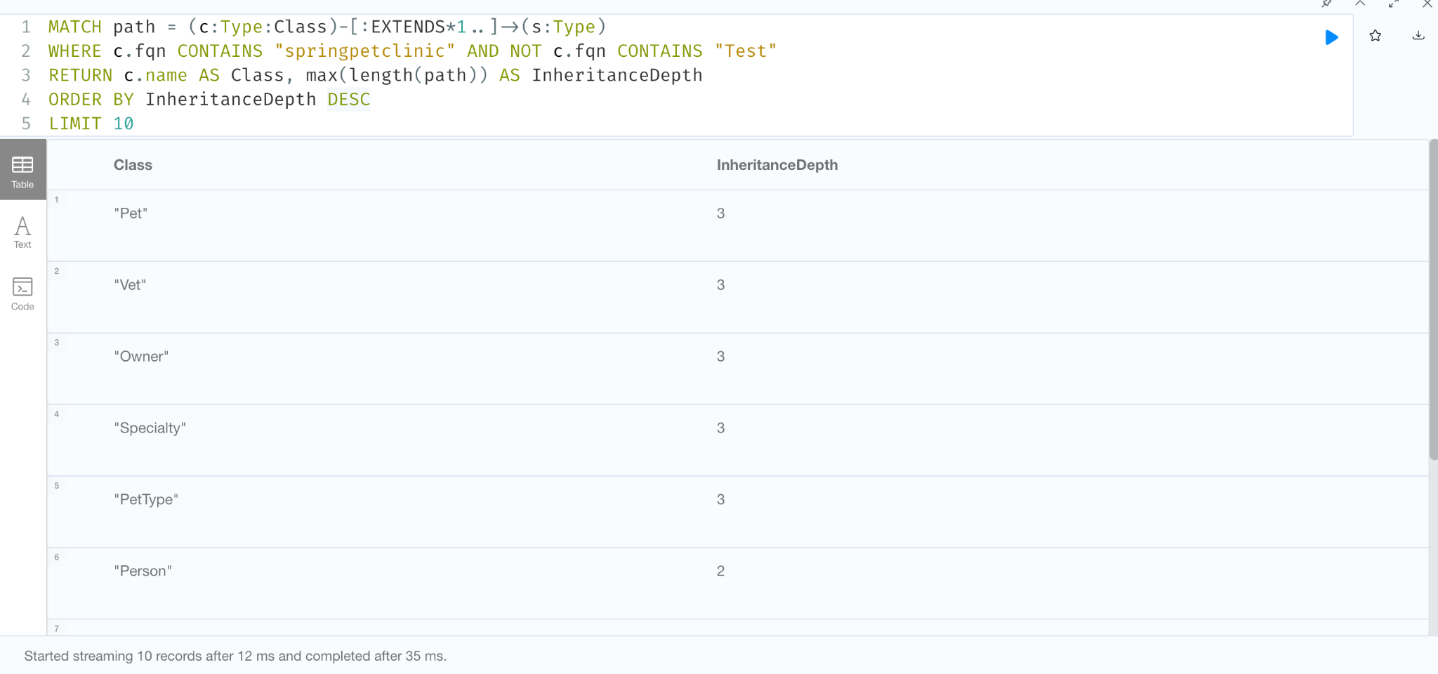
Inheritance Depth (DIT) · Q-9
INTERPRETATION & FUTURE-PROOF RELEVANCE
Measures Depth of Inheritance Tree (DIT); how many levels a class sits above its base class; to evaluate hierarchy complexity
Maximum depth is only 3 across the whole project; a shallow, healthy hierarchy
Pet, Vet, Owner, Specialty, PetType (depth 3) all inherit through the chain BaseEntity → NamedEntity → Person
Shallow inheritance; a base-class edit ripples to fewer descendants; easier, safer changes
Deep trees (DIT > 5) are a future-proof risk; PetClinic stays well within safe limits

Slide 16
Query Findings & Future-Proof Verdict
Findings
9 queries across 4 future-proof factors; complements SonarQube
Reusability: 69% → Whole Project, 59% → Production System
Maintainability: low method/field counts, no god classes
Changeability: low coupling dependency (max 4), shallow inheritance (depth 3)
Encapsulation: Fields well protected; but methods are mostly public, more private helper methods would make it more future proof
Weaknesses
Methods are mostly public: 8/10 classes have 0 private methods (Owner: 14 public/0 private)
Leaked field: Owner.bookedServices is public; editable without validation
Owner can be a god-class candidate: highest in methods (21) and among the top in fields (5)
Test gaps: 65.8% coverage; contract feature least covered
Small-project limits: with a small codebase, metrics reveal less than on a large system
Future Proof aspect covered | Queries
Reusability | Q1 (Reuse Factor), Q2 (Most Reused), Q6 (Reuse Cost-Benefit)
Maintainability | Q3 (Methods per Class), Q4 (Fields per Class)
Changeability | Q5 (Coupling), Q9 (Inheritance Depth)
Encapsulation | Q7 (Method Visibility), Q8 (Field Visibility)

Slide 17
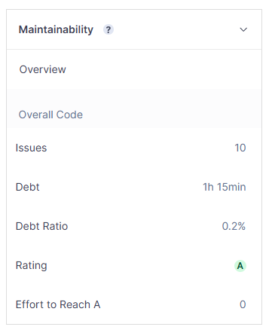
Technical Debt & Maintainability
INTERPRETATION & FUTURE-PROOF RELEVANCE
Only 1h 15min effort needed to resolve all identified maintainability issues
10 minor code smells - no bugs, no security vulnerabilities, but TODO comments are reported as maintainability issues.
A 0.2% debt ratio means developers spend almost no time fighting the codebase
Low technical debt reduces future maintenance costs and improves adaptability
Debt accumulates silently - keeping it low now prevents exponential future cost

Slide 18
Summary & Overall Assessment
SONARQUBE FINDINGS
JQASSISTANT FINDINGS
Quality Gate: Passed
Coverage: 65.8%
Duplication: 0%
Technical Debt Ratio: 0.2%
Maintainability Rating: A
Security Rating: A
Reuse Factor: 69%
Average Reuse per Asset: 2.79
Low production coupling
Clear and coherent domain model
Core entities correctly shared
Overall Assessment
The project demonstrates strong reusability, low technical debt, good maintainability, and reasonable test coverage — supporting the principles of Future-Proof Software Systems.

